Slide 1
MuscleHub
Codecademy - Capstone project 3

Slide 2
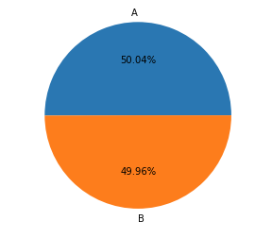
Description A/B test
Group A: people that do a fitness test
Group B: visitors that did not do a fitness test
3 hypotheses tested:
1. There is no difference in number of applications between people who do a fitness test and people who don’t
2. People who take the fitness test are not more likely to purchase a membership if they picked up an application
3. From all people who visit MuscleHub, There is no difference between the group that did or did not do the fitness test in terms of conversion to membership.

Slide 3
Available dataset consists of 4 tables in SQLlite
Available dataset consists of 4 tables in SQLlite
visits contains information about potential gym customers who have visited MuscleHub
fitness_tests contains information about potential customers in "Group A", who were given a fitness test
applications contains information about any potential customers (both "Group A" and "Group B") who filled out an application. Not everyone in visits will have filled out an application.
purchases contains information about customers who purchased a membership to MuscleHub.
Tables joined on first name, last name and e-mail address
Only data incorporated as of 7-1-2017 (start of A/B test)

Slide 4
The results of the three hypothesis tests method: Chi square
Why did I use Chi square?: categorical variables, with more than one sample
Hypotheses | Outcome
1. There is no difference in number of applications between people who do a fitness test and people who don’t | p = 0.001 So visitors who did not do a fitness test converted significantly better to aplications
2. People who take the fitness test are not more likely to purchase a membership if they picked up an application | p=0.43 So indeed there is no significant difference between people who took the test and people who didn’ t
3. From all people who visit MuscleHub, There is no difference between the group that did or did not do the fitness test in terms of conversion to membership. | p=0.01 This means that visitors that did not do a fitness test covert significantly better into membership

Slide 5
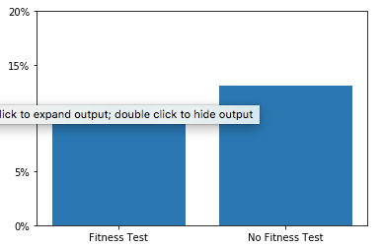
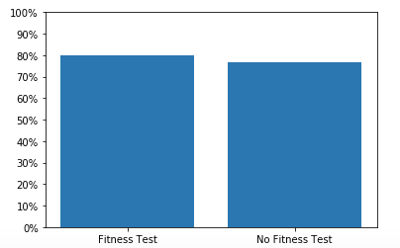
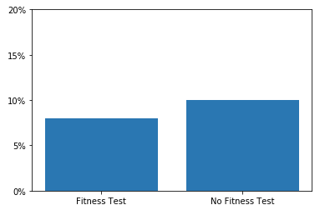
Summary of the qualitative data
Percent of Visitors who Apply
Percent of Applicants who Purchase
Percent of Visitors who purchase

Slide 6
Recommendation: skip the fitness test
Skip the fitness test, It reduces conversion of visitors to membership
Once applications has been picked-up, people who did the fitness test also don’t convert better to membership

